Slide 1
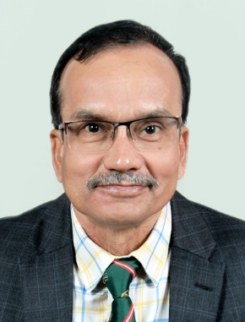
FROSTALKS
Assessment of Ground Water Vulnerability to Non-point Source Pollutants – Experience from Case Studies
Session Chair: Dr Purnendu Misra, Retd. Joint Director General of Shipping (tech) and Vice President, FROST
Speaker
Professor R. K. Panda, IIT Bhubaneswar,
formerly IIT Kharagpur, Former Dean (R&D), former Dean(AA&IR), Former Head of SIF and former Head of SEOCS, IIT Bhubaneswar
PHOTO HERE
z
WEBINAR: 05 JUNE 2021 (Saturday), World Environment Day, 04:30 PM IST
Google Meeting Link: https://meet.google.com/btd-rphx-hxr
Forum for River and Ocean Scientists and Technologists Odisha
(www.frostodisha.com)

